Slide 1
CI/CD Tooling
Kwok Kan

Slide 2

What is CI/CD?
CI is continuous integration
  Code gets checked in and it builds
CD is continuous deployment / delivery
  Code get deployed onto a server

Slide 3
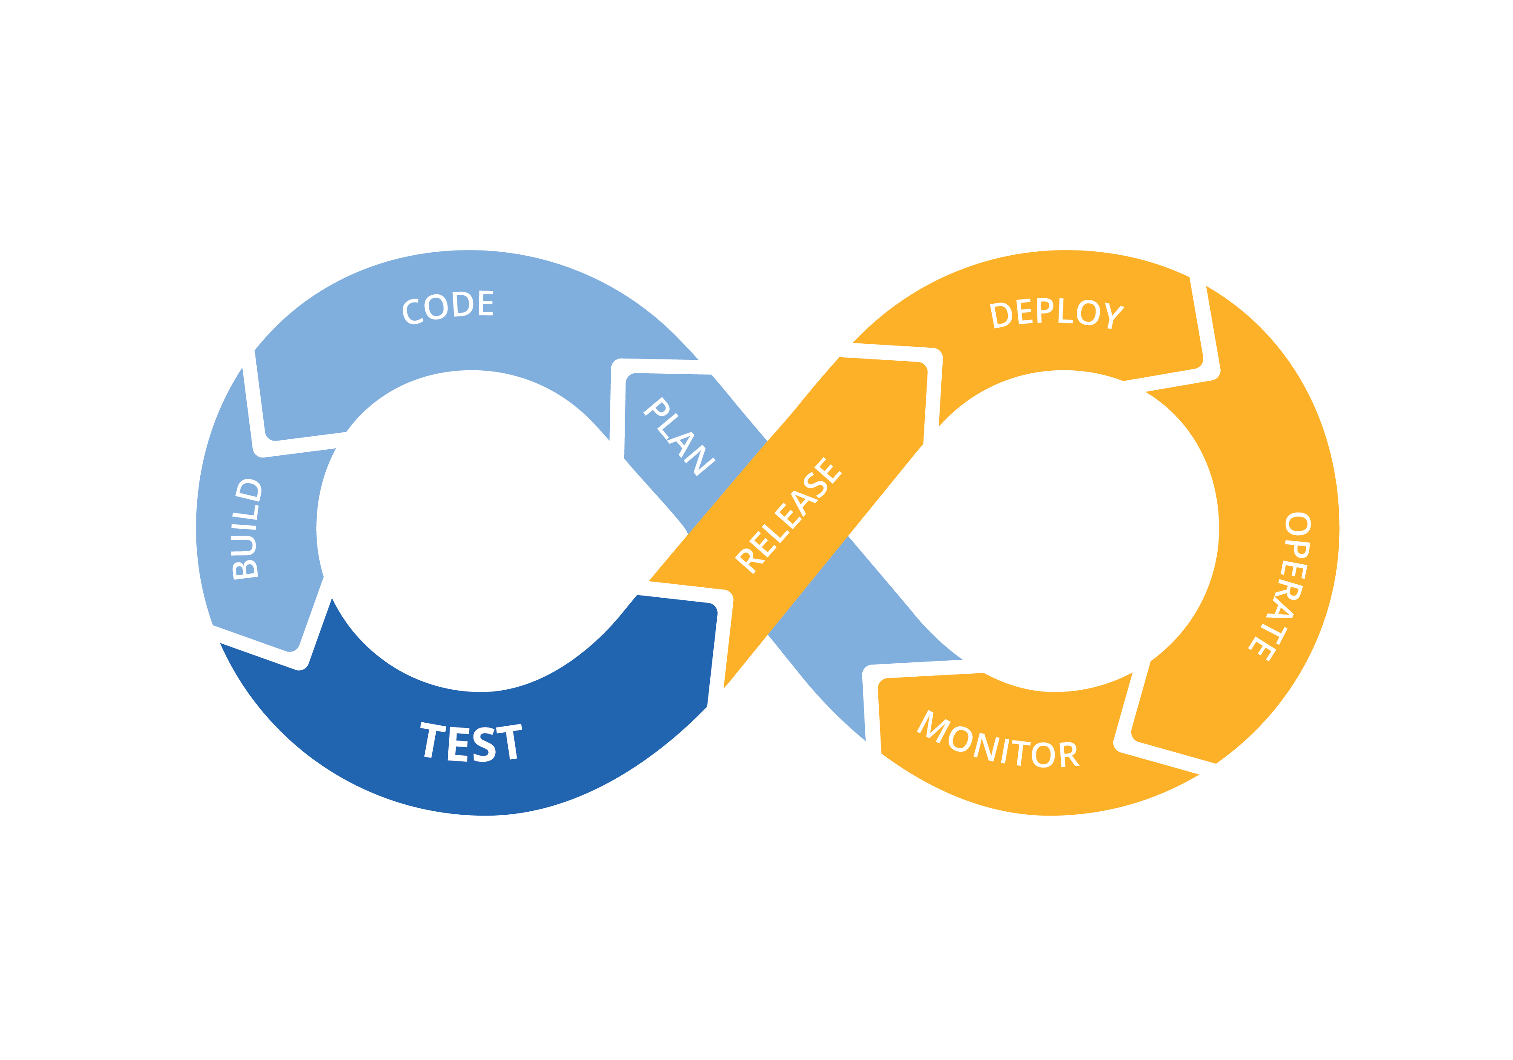
What is CI/CD?

Slide 4
What tools does this talk cover
Bits which are overlooked in CI/CD
Aimed at .NET devs
  C#
  JavaScript/TypeScript
GitHub as source code provider

Slide 5
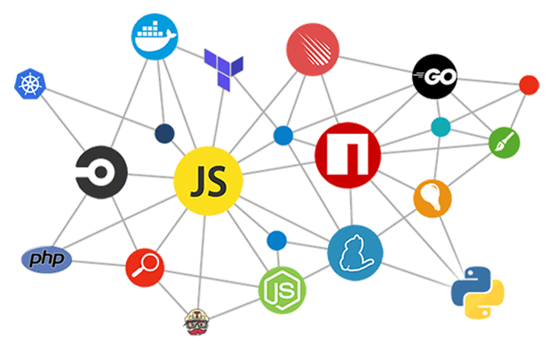

Dependency management
Renovate (https://renovate.whitesourcesoftware.com/)

Slide 6
Renovate features
Automatic dependency updates
Supports:
  .NET Core
  npm
  Docker
  And many more
Monorepo support
Customisable (e.g. update times, package policies, labels, etc)

Slide 7
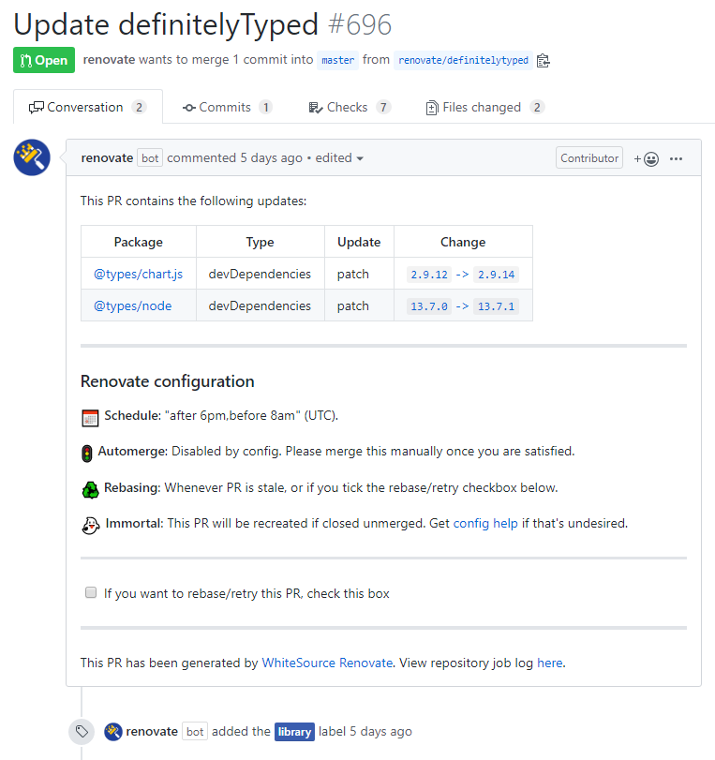
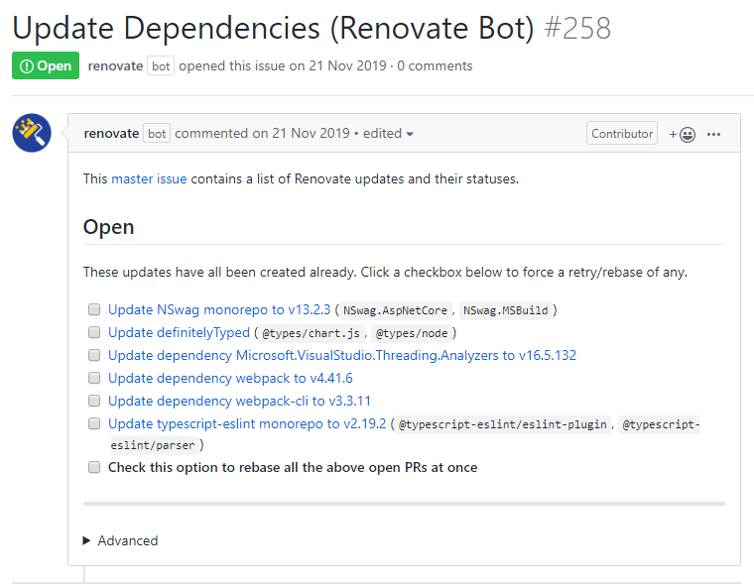
Renovate features

Slide 8
Renovate demo

Slide 9
Renovate benefits
Updating packages isn’t a chore anymore
jQuery use case (https://blog.cloudflare.com/javascript-libraries-are-almost-never-updated/)
Great when combined with automated tests
Forces you to semantically version if using for internal libs

Slide 10

Code coverage
Codecov (https://codecov.io/)

Slide 11
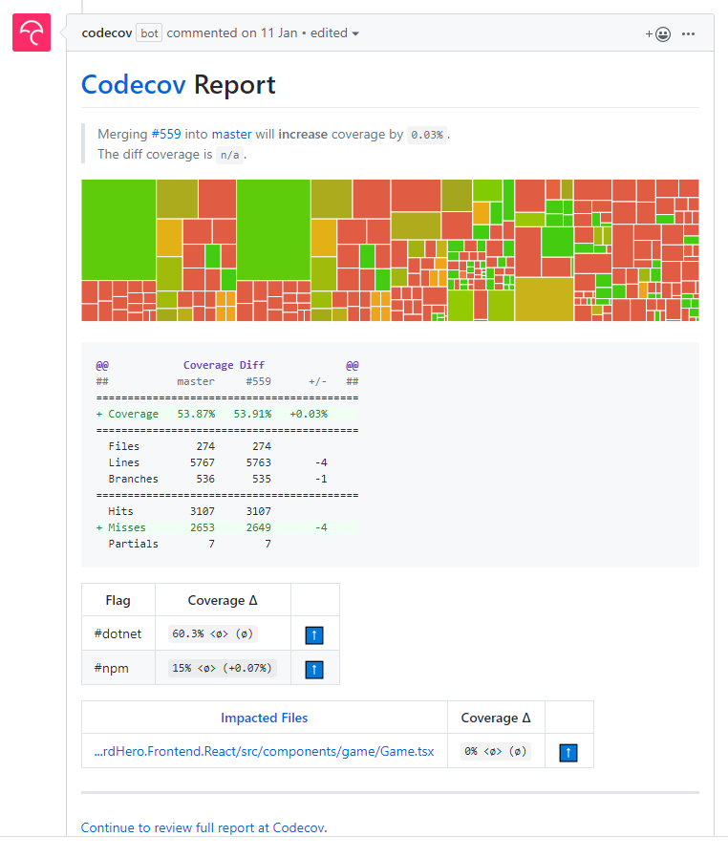
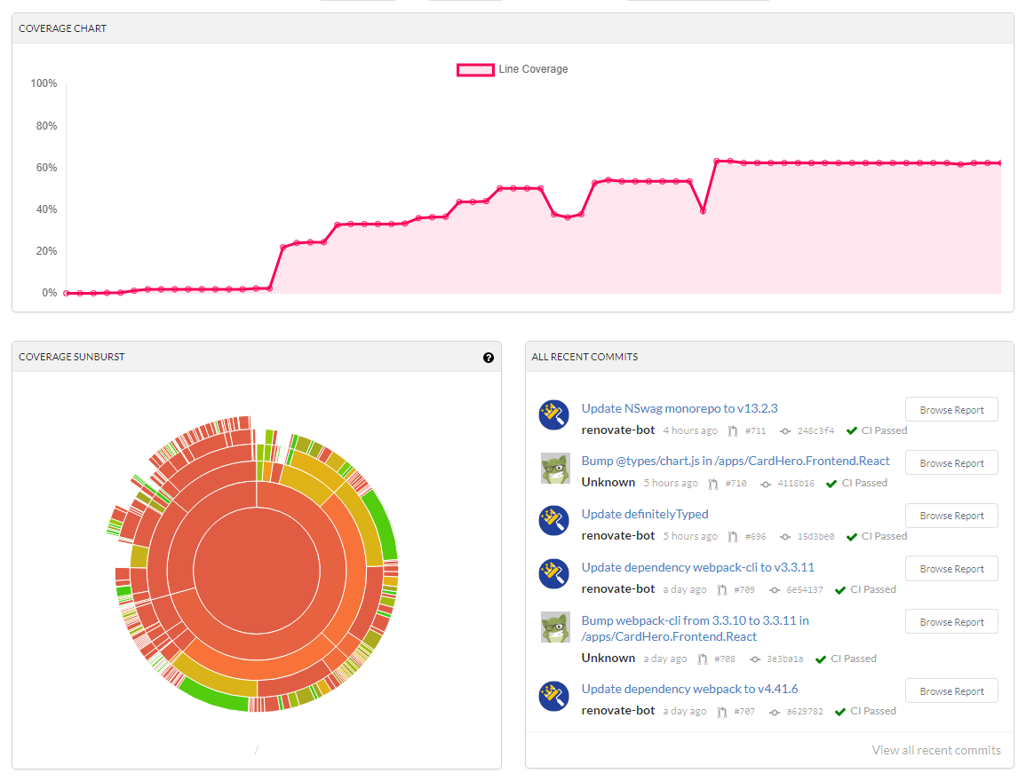
Codecov features

Slide 12
Codecov demo

Slide 13
Codecov benefits
Automated code coverage on pull request
Keeps history of coverage
Can fail build if certain requirements not met
Extensive database of bad code

Slide 14

Code quality
LGTM (https://semmle.com/lgtm)

Slide 15
LGTM features
Checks for potential issues in pull requests
Keeps track of potential issues in codebase
Provides samples on how to fix
C#/JavaScript/TypeScript support

Slide 16
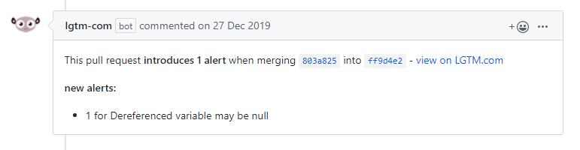
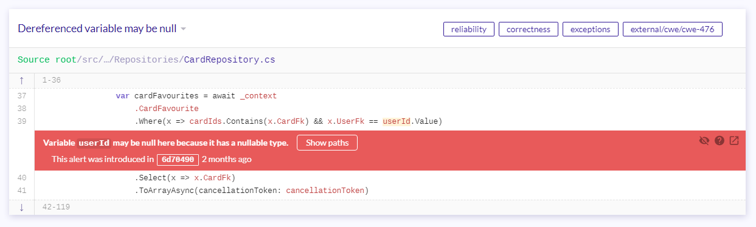
LGTM features

Slide 17
LGTM demo

Slide 18
LGTM benefits
Automated code analysis on pull request
May pick up potential issues other reviewers may not

Slide 19
Conclusion
Renovate
  Always have (even if just to see what updates)
Codecov
  Depends on if team cares about coverage
LGTM
  Should have although build times may be dramatically slower

